Slide 1



Boosting ESG scores for GHG-intensive industrial design using iterative real-time machine-learning and artificial intelligence technologies.

Slide 2

Problem
Miranda lives in Port Arthur, TX, and suffers from a respiratory illness.
Like many of other health-conscious people, she struggles to find a mobile solution that:
Provides real-time information on the air pollutants that directly impact her.
Predicts her future exposure to air pollutants.
Predicts possible health impacts of exposure to various pollutants.
Miranda

Slide 3

Problem
Acme Engineering based in Port Arthur, ON, and designs GHG-intensive chemical , energy and pharmaceutical industrial processes.
They want real-time data for more iterative designs of a new renewable natural gas (RNG) facility to protect Miranda, their employees and the community.
Like many of other ESG-conscious engineering firms, they struggle to find a solution that:
Acme Engineering
Provides real-time, relevant information on the populations impacted by their designs.
Gives iterative feedback on their design changes.

Slide 4




Problem
Available solutions don't fit ACME Engineering’s or Miranda’s needs perfectly
Fitbit
Google Fit
Does not give Miranda predictive air pollution information on HER exposure.
Does not give Miranda predictive air pollution information on HER exposure.
Does not give Miranda predictive air pollution information on HER exposure.
Does not give ACME Engineering real-time live information for better designs.
Does not give ACME Engineering real-time live information for better designs.
Does not give ACME Engineering real-time live information for better designs.

Slide 5
Problem
Rapid increase in exposure to air pollutants to people in communities and need for ESG compliance using mobile real-time, TARGETED exposure information.
15,400 deaths
139k engineering firms
17%-37% increase
Of a Canadian population of 36million, 15,400 premature deaths are attributed to NO₂ exposure, particulate matter exposure (PM_{2.5}), and ozone (O₃) exposure, representing 42 per 100,000 people at a health care cost of $114 billion (hospital admissions and ER admissions).
Since COVID, people are more conscious of the impact of air quality on health. Among nutritional consumers in Canada, 36% of those ages 18 – 34, 37% of adults ages 35 – 44, 30% of those ages 45 – 54 and 17% of those 55+ are taking nutritional products more since COVID-19.
139k engineering firms in the US, alone, generating $360 billion dollars in revenue. They design what may be GHG-intensive processes using static data tables based on communities sometimes far away. Impacted community information is rarely available.
SOURCE: https://www.newswire.ca/news-releases/roughly-one-third-of-us-and-one-quarter-of-canadian-nutritional-consumers-take-more-vitamins-minerals-and-supplements-since-covid-19-890190717.html
SOURCES:
https://peakbusinessvaluation.com/valuation-multiples-for-an-engineering-firm/#:~:text=There%20are%20over%20139%2C000%20engineering,%24360%20billion%20dollars%20in%20revenue.
2)https://en.wikipedia.org/wiki/OREDA#cite_note-DNV_GL-1
3)https://www.oreda.com/
SOURCE: https://www.canada.ca/en/health-canada/services/publications/healthy-living/2021-health-effects-indoor-air-pollution.html

Slide 6
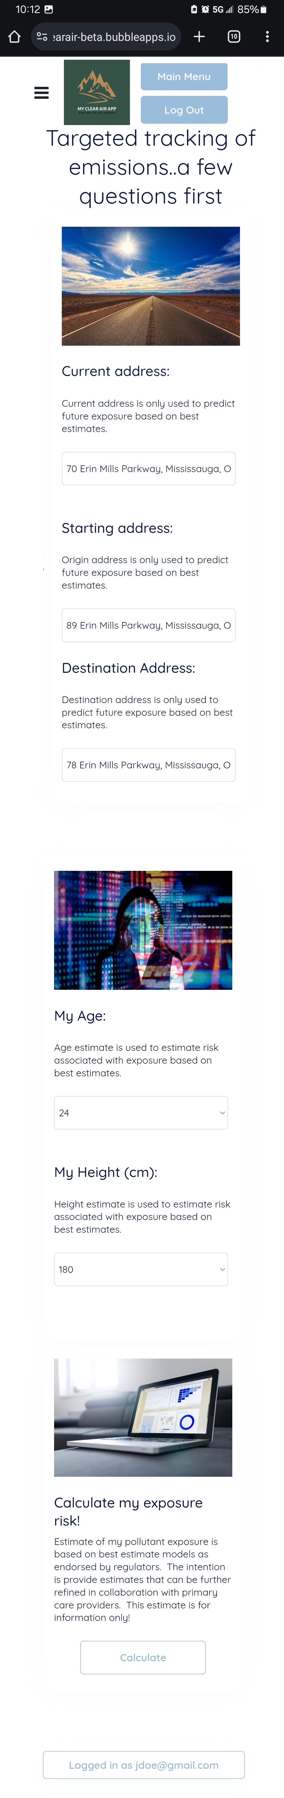
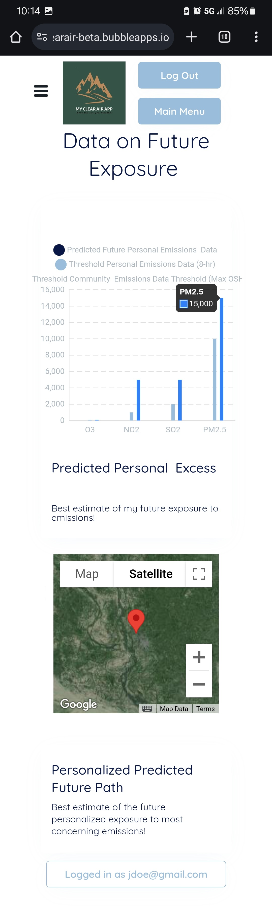
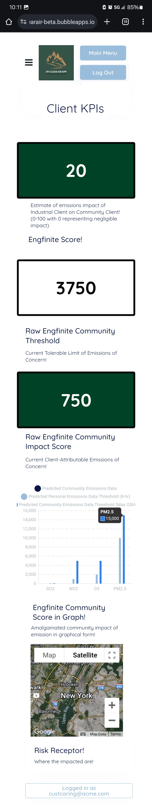
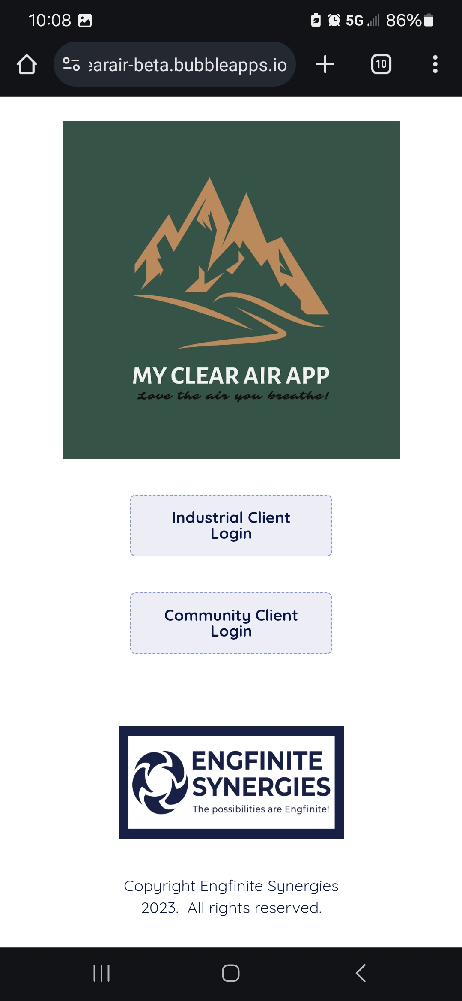
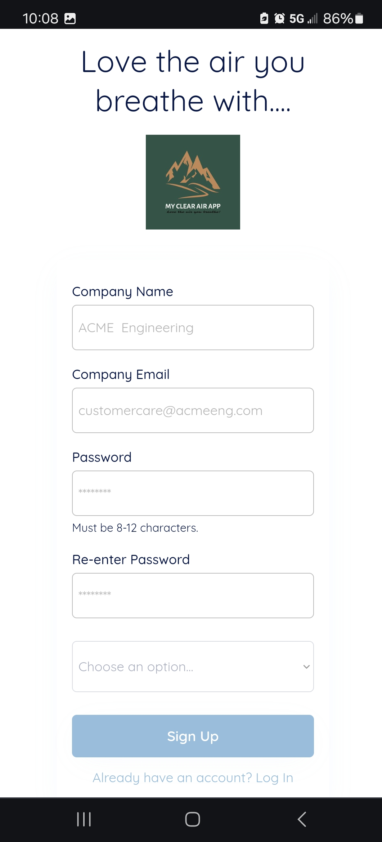
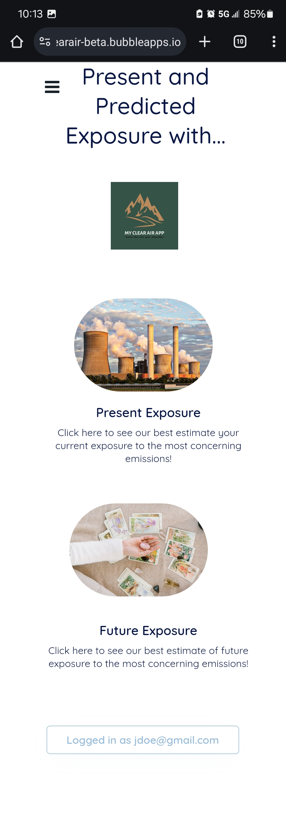
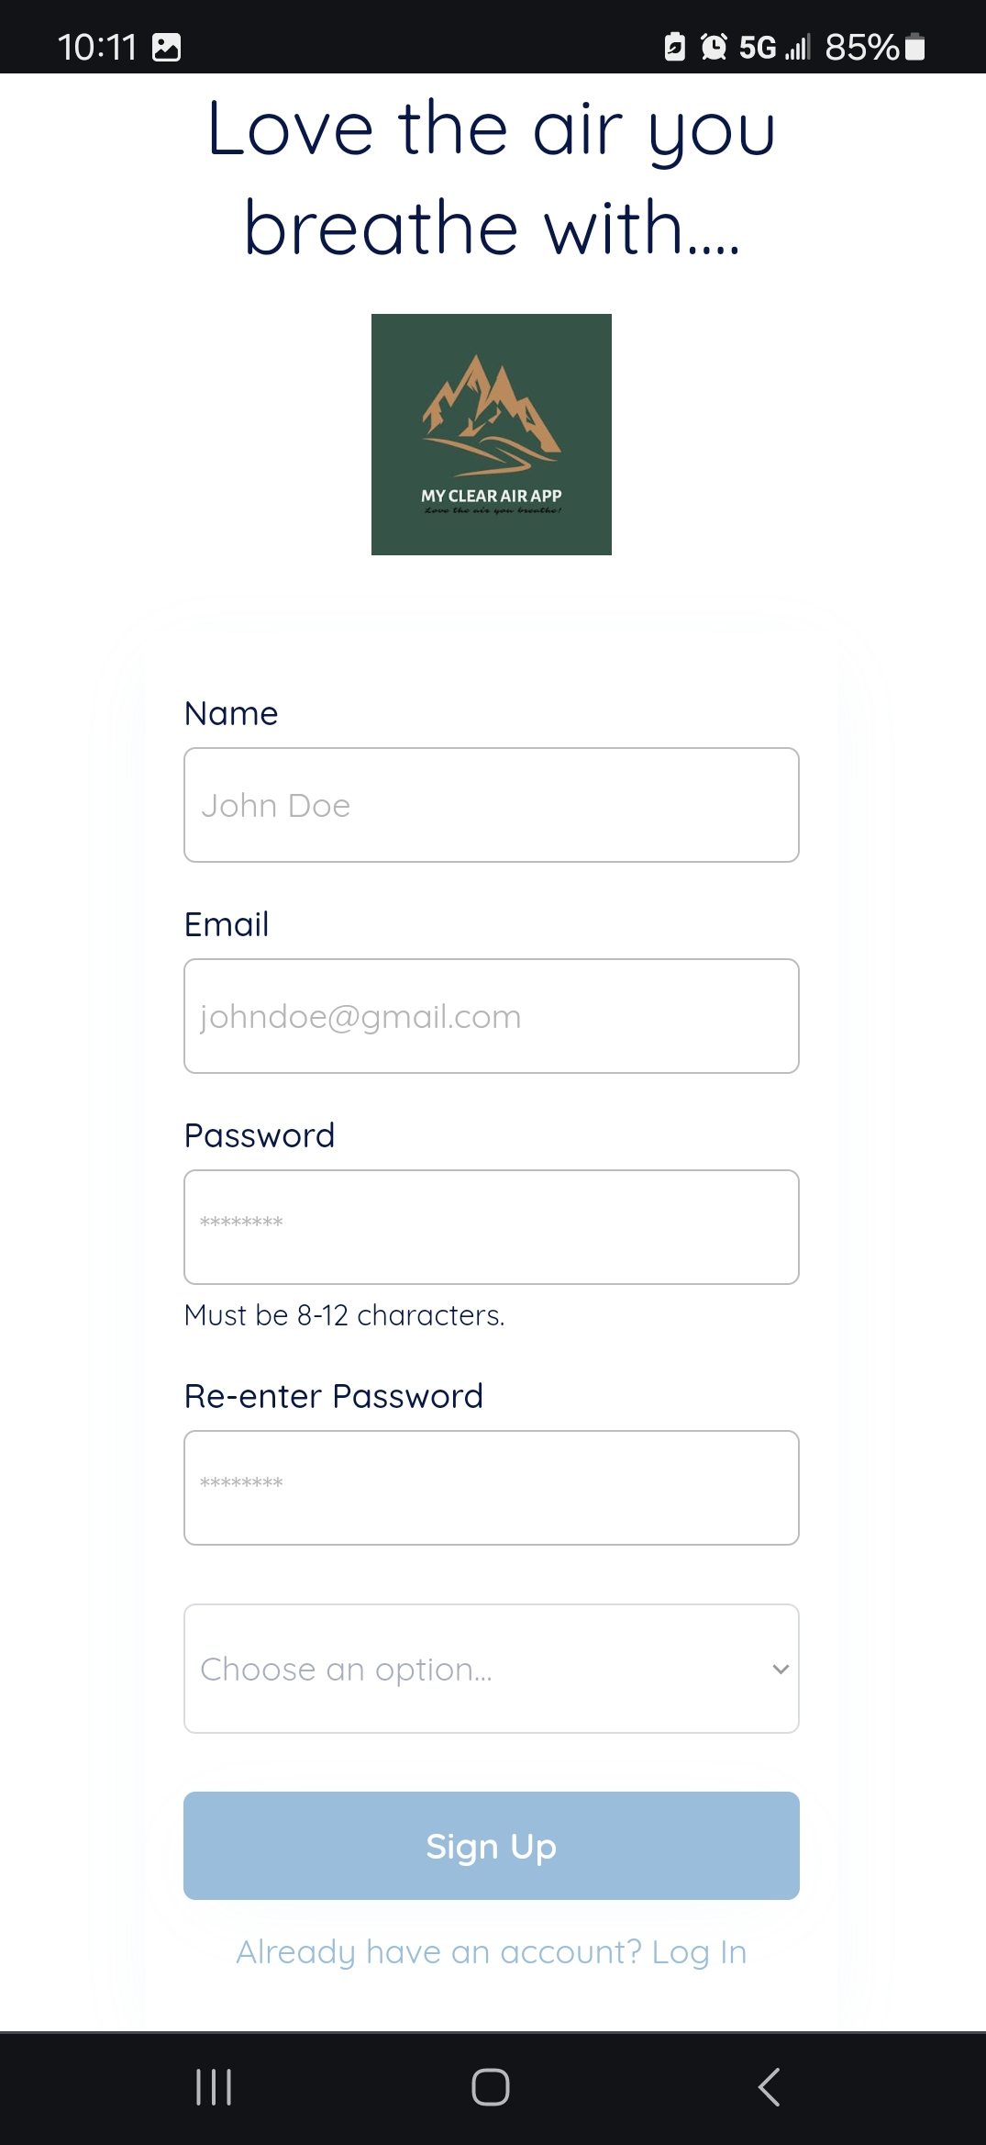
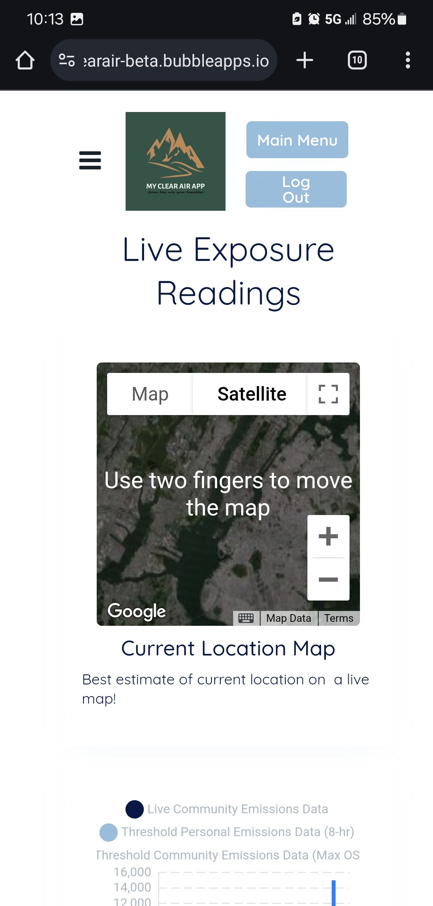
Solutions #1 (SaaS)
Tracks pollution information based on location of impacted people.
Predicts future exposure of people.
Provides iterative feedback using artificial intelligence add-on.
Selectivity-based Worker Ganntt Chart with Selectivity based on Design Error

Slide 7
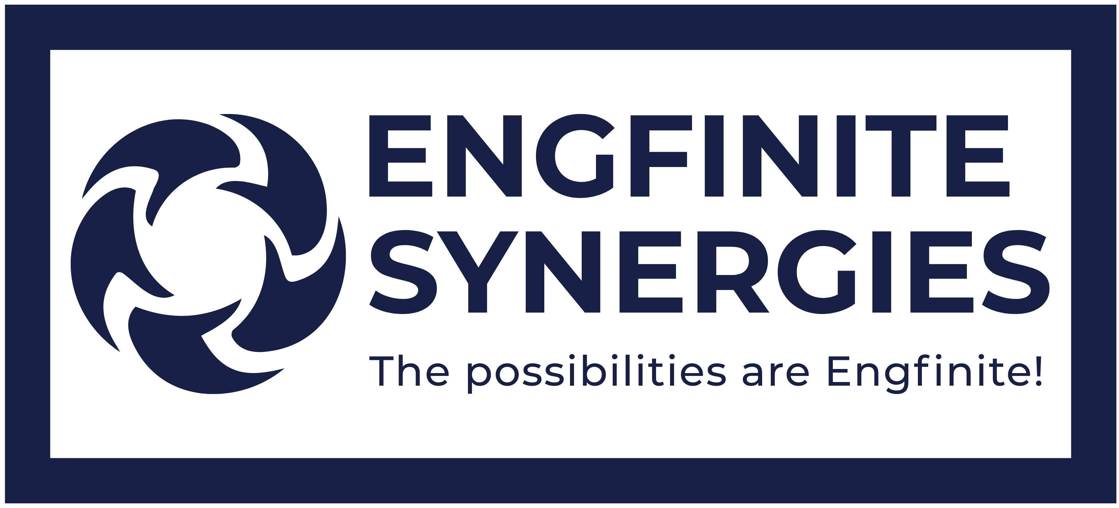

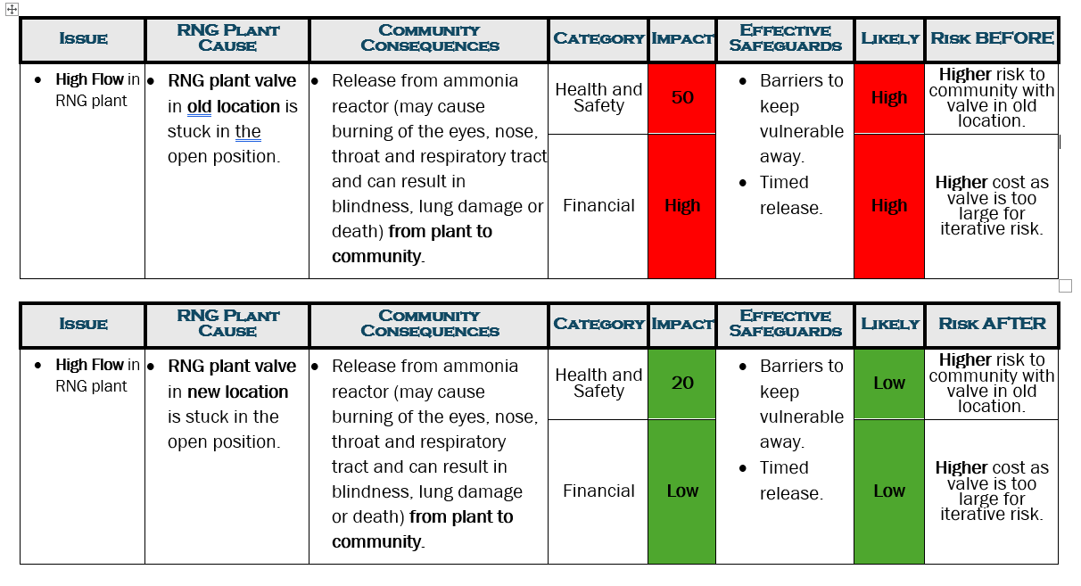
Solutions #2 (Iterative Enhanced Risk Analysis)
Lower risk to community with more accurate data-driven design
Lower cost with more accurate data-driven design.

Slide 8
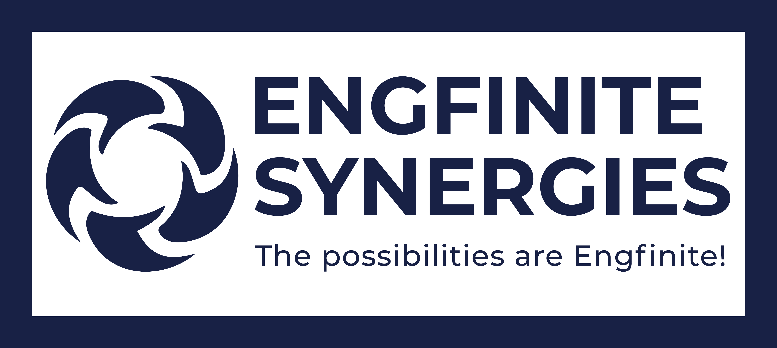
Competitive Analysis
Competitive edge in fitness app industry
Air Pollution Location Data
Predictive Exposure
Past Exposure
ESG component
Polluting Locations
Provider Locations
Fitbit
Google Fit
NOTE: EngFinite Synergies technology does not replace advice from a health care provider. It only enhances the advice by providing a record localized environmental pollution exposure that a provider may use to optimize treatments.

Slide 9
Revenue Forecast
Scalable & sustainable
revenue streams
Revenue
Stream 1
Revenue
Stream 2
Revenue
Stream 3
Ultra Premium services for engineering firms designing industrial operations.
Monthly retainer rate showing how designs have a real-time impact on people in area and selection of preferred worker schedules.
Premium service app charges insurance and realty firms information on the risk associated with the current designs to neighbouring communities.
Basic service app engineering, insurance and realty static information and community members information on preferred daily paths.

Slide 10
Opportunity
The disruption of fitness app and ESG app industry
2007
2014
2022
Address fitness concerns broadly speaking to environmental pollutants.
Describe environmental pollutants in general area but not localized or linked to health solutions.
Addresses fitness concerns and environmental pollutants in one simple solution.

Slide 11
Market Size
Huge market opportunity
Health and safety and the high reliance on labor mean social aspects of the environmental, social and governance (ESG) agenda have been and will remain a high priority for the engineering and construction (E&C) industry.
A recent EY survey showed 98% of investors indicate they evaluate ESG performance based on corporate disclosures.
SOURCE: https://assets.ey.com/content/dam/ey-sites/ey-com/en_us/topics/real-estate-hospitality-and-construction/ey-esg-reporting-in-engineering-and-construction-industry.pdf

Slide 12
Market Size
Huge market opportunity
“…the ESG space providing everything from standards, goals and guidance to company-level assessments. The principal areas include:
• Standards setters such as Global Reporting Initiative (GRI) and Sustainability Accounting Standards Board (SASB) that publish guidance for voluntary disclosure
• International goals and guidance, including Sustainable Development Goals (SDGs) and the Task Force on Climate-related Financial Disclosures (TCFD)
• Disclosure-based sustainability scores, including the Dow Jones Sustainability Index (DJSI) and Carbon Disclosure Project (CDP) that request data from companies via questionnaires
• Ratings agencies such as S&P, MSCI and Sustainalytics that create assessments of companies based on public and/or private information”
SOURCE: https://assets.ey.com/content/dam/ey-sites/ey-com/en_us/topics/real-estate-hospitality-and-construction/ey-esg-reporting-in-engineering-and-construction-industry.pdf

Slide 13

Market Size
Huge market opportunity
$1.1T
Partial available market*
The top 14 engineering firms in the world generate $1.10 trillion in revenue as of December 9th , 2020.”
SOURCE: https://finance.yahoo.com/news/14-largest-engineering-companies-world-212730095.html

Slide 14
Strategy
We are raising
$250,000

Slide 15
Strategy
Raising $250,000 to expand
Products
expansion
Ultra Premium Minimum Viable Product (International)
Basic Minimum Viable Product (International)
The expansion plan starts with creating a Basic usable app for customers exposed to pollutants from the design of a GHG-emitting facility.
The next step involves creating a Premium app for help businesses with information where pollution is not-critical to operations (e.g. realty firms, law firms, supplement stores).
The last step involves creating an Ultra Premium app where pollution is critical to operations (e.g. engineering firms).
Estimated date of
Launch: Aug 2026
Estimated date of
launch: Aug 2026
Premium Minimum Viable Product (International)
App enhancements for greater usability
Estimated date of
launch: Ongoing
Estimated date of
launch: Aug 2026

Slide 16
Strategy
Raising $250,000 to expand
D
Partnership plan with engineering firm on ESG-sensitive product.
Partnership and collaboration
Estimated period of partnership: Sep 2025-Dec 2025
P
Partnership community impacted by engineering design.
Partnerships planned with select engineering firms on designs where ESG compliance is desired.
Estimated period of partnership: Sep 2025-Dec 2025

Slide 17
Value Proposition
Why now?
First to market after COVID
Novel connections
Multiple revenue streams
Increase in supplement spending post-COVID (17%-37%) of already large $700M+ industry makes this an ideal time for the app focused on air-pollution exposure.
.
Novel way of connecting environmental pollutants to community-engagement.
Has B2C and B2B component.
Leveraging unique background of team in chemical engineering and medicine.
Mix of revenue streams based on B2C advertising and B2B retainer model minimizes risk.
Based on current AI technology and ESG focus.

Slide 18
Problem Solved
Miranda lives in Port Arthur, TX, and suffers from a respiratory illness.
She now has a mobile solution that:
Provides real-time information on the air pollutants that directly impact her.
Empowers her to modify her schedule to reduce her emissions exposure.
Predicts possible health impacts of exposure to various pollutants.
Miranda
“the ‘rule of threes’ gets at the desperate nature of what our bodies need: three minutes without oxygen, three days without water, three weeks without food.”
SOURCE: https://www.businessinsider.com/longest-survival-records-water-food-sleep-breathing-2016-5#the-rule-of-three-minutes-without-air-is-a-good-guideline-hold-your-breath-for-longer-and-you-run-the-risk-of-brain-damage-1

Slide 19
Problem
Acme Engineering based in Port Arthur, ON, and designs GHG-intensive chemical , energy and pharmaceutical industrial processes.
They have real-time data for more iterative designs to protect Miranda, their employees and the community.
Like few of other ESG-conscious engineering firms, they have a solution that:
Lowers cost by providing real-time, relevant information on the populations impacted by their designs (reduces overdesign).
Gives data to potentially decrease liability by giving iterative feedback on their design changes.
Lowers cost by optimizing the schedule of workers to as to minimize impactful exposure.

Slide 20
Team
Over 10 years of professional engineering experience
Founder of Engfinite Synergies Inc.
Professional Engineer (P.Eng.) License in Ontario and Alberta.
Certificate of Authorization from Professional Engineers of Ontario.
Masters in Engineering Management.
Bachelor of Engineering in Chemical Engineering.
Bachelor of Science in Biology.
Jason
Thomas
Engineering Director

Slide 21

Boosting ESG scores for GHG-intensive industrial design using iterative real-time machine-learning and artificial intelligence technologies.
Jason Thomas, P.Eng., M.E.M.
Engineering Director
customercare@engifinitesynergies.com
www.engfinitesynergies.com

